Slide 1
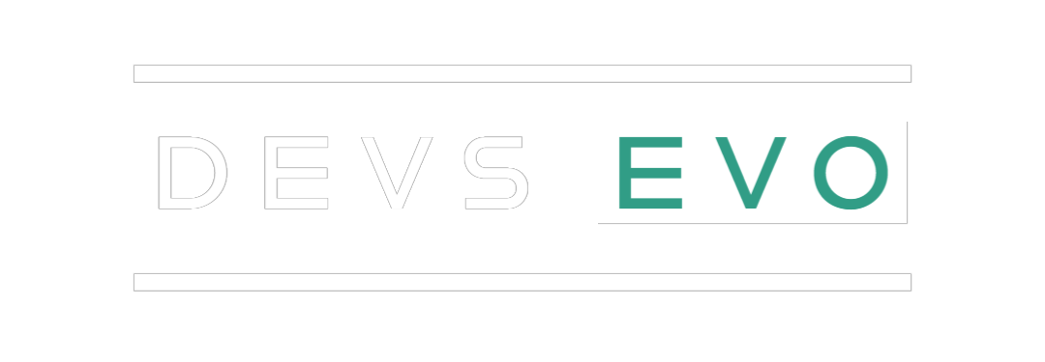
Decentralized chatting app
Fatheem Meeran .S
Mathan Raj .A.R
Sushvin .M

Slide 2
Centralized System:
Centralized systems are systems that use client/server architecture where one or more client nodes are directly connected to a central server.
This is the most commonly used type of system in many organizations where a client sends a request to a company server and receives the response.
Decentralized System:
Decentralized applications(dApps) are digital applications or programs that exist and run on a blockchain or peer-to-peer(P2P) network of computers instead of a single computer.
DApps are outside the purview and control of a single authority.
DApps which are often built on the blockchain can be developed for a variety of purposes including gaming, finance, and social media.

Slide 3
Blockchain
Blockchain technology is a structure that stores transactional records, also known as the block of the public in several databases, known as the “chain”, in a network connected through P2P nodes. Typically, this storage is referred to as a ‘digital ledger’.
Every transaction in this ledger is authorized by the digital signature of the owner, which authenticates the transaction and safeguards it from tampering. Hence, the information in digital ledger contains is highly secure.
Highly Secure:
It uses a digital signature feature to conduct fraud-free transactions making it impossible to corrupt or change the data of an individual by the other users without a specific digital signature.

Slide 4
Peer-to-peer(p2p) and Full nodes
Peer-to-Peer:
As a distributed ledger technology, blockchain records transactions as an immutable timestamped digital block that indicates senders and receivers.
No centralized authority manages the blockchain storage and only the participants can validate transactions among each other.
Full Nodes:
A full node is a program that fully validates transactions and blocks. Almost all full nodes help the network by accepting transactions and blocks from other full nodes, validating those transactions as blocks , and then relaying them to further full nodes.
Most full nodes also serve lightweight clients by allowing them to transmit their transactions to the network and by notifying them when a transaction affects their wallet. If not enough nodes perform this function, clients won’t be able to connect through the P2P network.

Slide 5
Mining
The method by which tokens are generated and the transactions involving new tokens are verified is known as mining.
It entails massive, decentralized networks of computers all over the world that verify and safeguard blockchain, which are virtual ledgers that record crypto transactions.
Crypto Mining has 2 goals:
It generates new tokens and it verifies the authenticity of existing tokens transaction on the blockchain.
Newly produced tokens to boost their wallets.

Slide 6
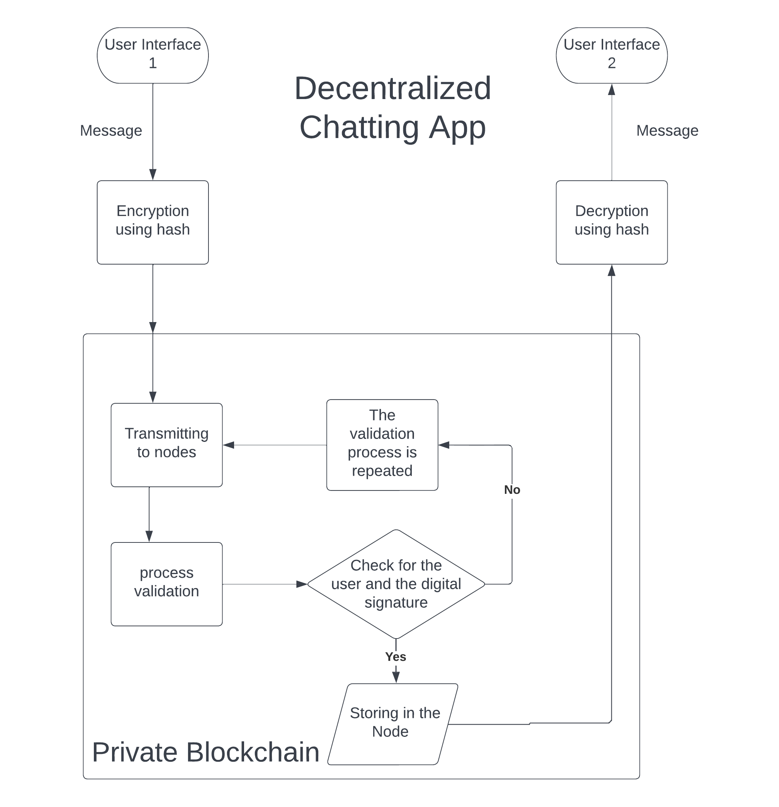
Block Diagram

Slide 7
conclusion
We create a blockchain which can be used to store data and transfer messages securely, in the form of blocks.
And the data stored in the blockchain only visible to the users.
Which let the user to be anonymous.

